Slide 1
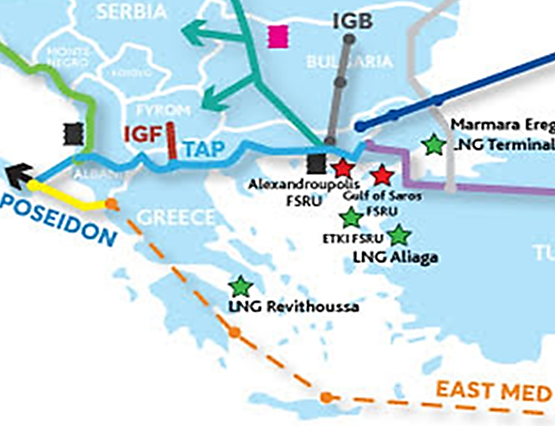
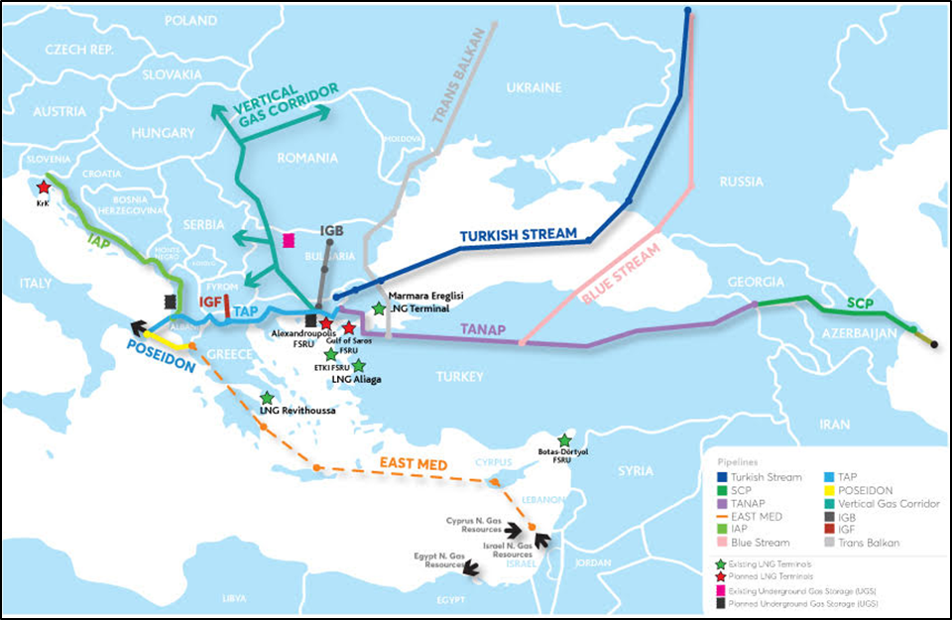
An Expanded Southern Gas Corridor
NB.: The TANAP and TAP gas pipelines as well as Turkish Stream are under construction, with IGB at an advanced planning stage with FID already taken. The IAP, the IGI Poseidon in connection with East Med pipeline and the Vertical Corridor and the IGF are still in the study phase. Blue Stream and Trans Balkan are existing pipelines.
Source: IENE

Slide 2
Anticipated Gas Volumes Through Greece (2020-2030)

Slide 3
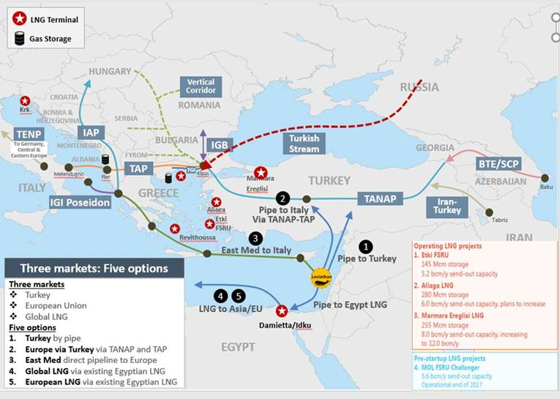
Gas Routes in SEE and East Mediterranean

Slide 4
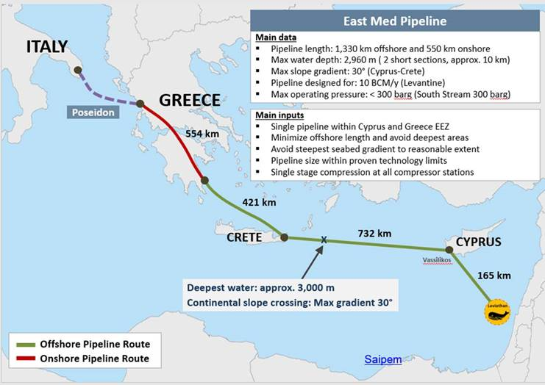
East Med Gas Pipeline

